Slide 1
Implementing flexibility through demand response aggregation in Europe
Özge Okur
PhD candidate, TU Delft
o.okur@tudelft.nl
dr ir Zofia Lukszo
Prof dr ir Paulien Herder
Supervisory Team, TU Delft
22 February 2017
Project E : Modelling Lab for smart grids,
smart policies and smart entrepreneurship

Slide 2
Outline
Introduction
Background information about aggregators
The need for research
Research Question / Sub-questions
Expected Outcome

Slide 3
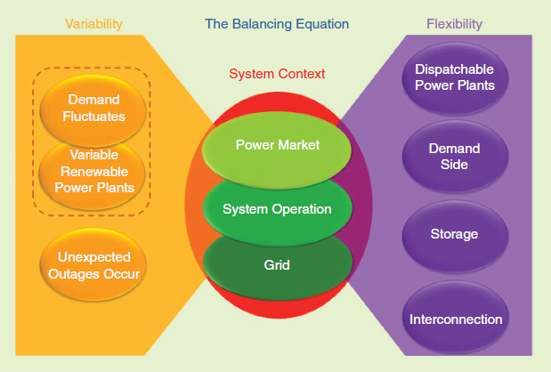
Introduction
From: Holttinen, H., et.al.,The Flexibility Workout: Managing Variable Resources and Assessing the Need for Power System Modification, IEEE Power and Energy Magazine, 11(6), 2013

Slide 4
Demand Response Aggregators

Slide 5
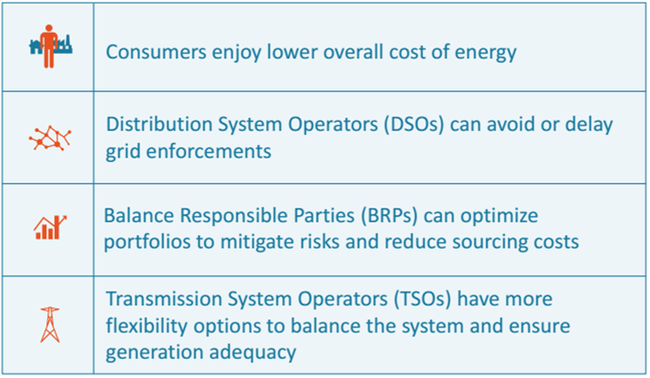
Value of aggregators
From: USEF Aggregator Implementation Models

Slide 6
Aggregators in Europe
Aggregator | Country
Flexitricity | UK
Kiwi Power | UK
Energy Pool | France
Next Kraftwerke | Germany
Actility | The Netherlands
Energie Koplopers | The Netherlands (project)
REstore | Ger., Fran., Benelux, UK

Slide 7
The need for research
Participation of aggregators : clarifying the role of aggregators / independent aggregators
Different regulations regarding aggregators in EU members

Slide 8
The need for research
Aggregators and their interactions with other market players
Contractual relations between aggregators and consumers
Willingness to be controlled by an aggregator / Acceptability of an aggregator

Slide 9
Research Question
Given the increasing importance of flexibility in the European electricity system, how can demand response be promoted successfully through aggregators in a smart grid?

Slide 10
Sub-questions
What are the existing regulations for aggregators in EU members?
How can European electricity markets be designed to allow/increase the participation of aggregators?
How would emergence of aggregators impact other electricity market actors/customers?

Slide 11
Expected Result
A framework to stimulate the market integration of demand side management through aggregators

Slide 12
First Case Study
Uncertainties from wind production, DAM prices and EV mobility
EV aggregator with balance responsibility
Electric Vehicle (EV) Aggregator
Day-ahead Market (DAM)
Wind Power Producer
Notes:
Make a picture of the case study
Mention uncertainties

Slide 13
Thank you very much!
Questions?
Suggestions?

